Slide 1


Building a Family of Data Augmentation Models for Low-cost LLM Fine-tuning on the Cloud
Yuanhao Yue
Fudan University
Notes:
Good morning, everyone I’m Yue Yuanhao from Fudan University. The topic I am going to report on today is “Building a Family of Data Augmentation Models for Low-cost LLM Fine-tuning on the Cloud.” This is the work I did during my research internship at Alibaba Cloud. We trained a series of small language models which specialize in prompt refinement and data augmentation. And we successfully deployed them into Alibaba Cloud's services and products.

Slide 2
Motivation
In order to spetialize LLMs in specific domains or tasks,
The construction and annotation of datasets are costly.
Open-source models have become strong enough to handle dataset construction in many scenarios.
We present a family of data augmentation models designed to significantly improve the efficiency for model fine-tuning.
Prompt Refinement
Prompt Expansion
Notes:
As a cloud service provider, our clients often need to fine-tune large language models (LLMs) to specialize in their domain and tasks.
However, the construction and annotation of datasets in specific domains are always very costly. Apart from using superior and expensive closed-source LLM APIs to construct datasets, some open-source models have become strong enough to handle dataset construction in many scenarios.
Thus, we present a family of data augmentation models designed to significantly improve the efficiency for model fine-tuning. These models, trained based on sufficiently small LLMs, support key functionalities with low inference costs: prompt expansion, prompt refinement,

Slide 3
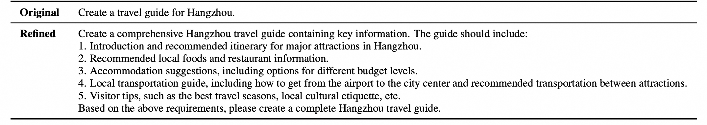
Tasks
Prompt Refinement:
Rewrite prompts to enable LLMs to generate more helpful responses.
Notes:
Let me briefly introduce what prompt refinement and prompt expansion are.
Prompt refinement is a type of prompt engineering, which involves rewriting prompts to enable large language models (LLMs) to generate more detailed and more helpful responses.
Just like what is shown in the table on my slide. The refined prompt enables LLMs to produce longer and more comprehensive travel planning suggestions.

Slide 4
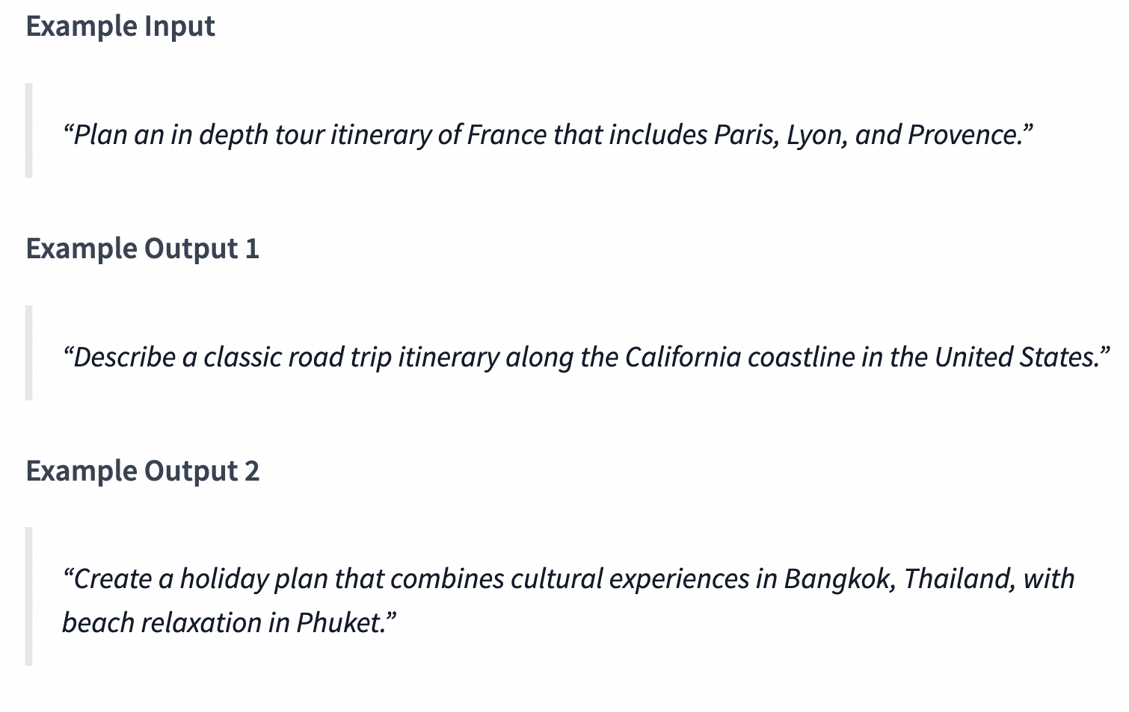
Tasks
Prompt Expansion:
To generate new instructions with similar task types, but different semantic information.
Notes:
The task is to expand the current instruction to generate new instructions with similar task types, similar difficulty, but different semantic information.
We can understand this process as data augmentation for the questions in a Q-A pair dataset.

Slide 5
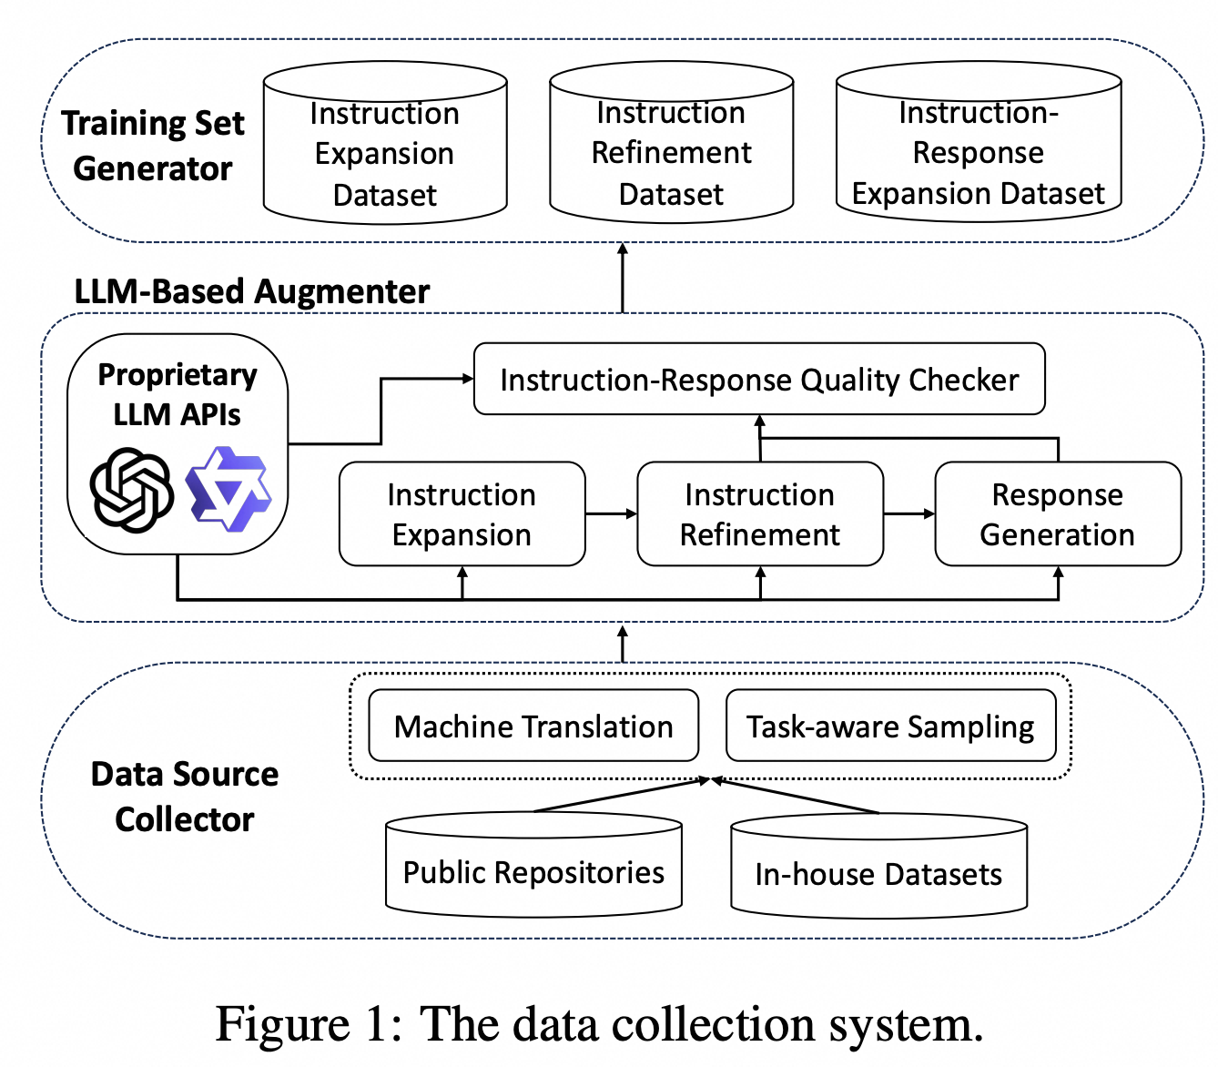
Well-curated dataset for training
Dataset Diversity:
Balanced task re-sampling
Balanced language distribution (EN & CH)
Various data sources
Automatic Annotation:
Well-curated annotation prompt.
Human annotated in-context examples
Notes:
the diversity and quality of instructional data are vital to the effectiveness of SFT
We integrates public datasets like OpenHermes 2.5, Cleaned Alpaca Dataset, and LCCD, along with an in-house dataset from LLM API services to understand online user preferences. Primarily focusing on English and Chinese, it employs machine translation for untranslated pairs, with a similar process applicable for other languages.
Response Generation. With expanded and refined instructions, we manually annotated several examples to write an in-context learning prompt (see Table 7) to ask these powerful LLMs to generate responses with higher quality and more details. This step is similar to distill the knowledge from these LLMs for training specialized small models (Yue et al., 2024; Hsieh et al., 2023). In addition, to ensure the generated instructions and instruction-response pairs are factually correct, we leverage the LLMs to check the data quality and filter out low-quality ones. The prompt templates for instruction expansion, refinement and quality checking are listed in Appendix B.

Slide 6
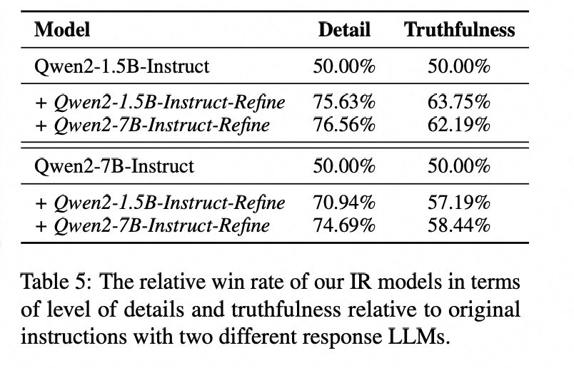
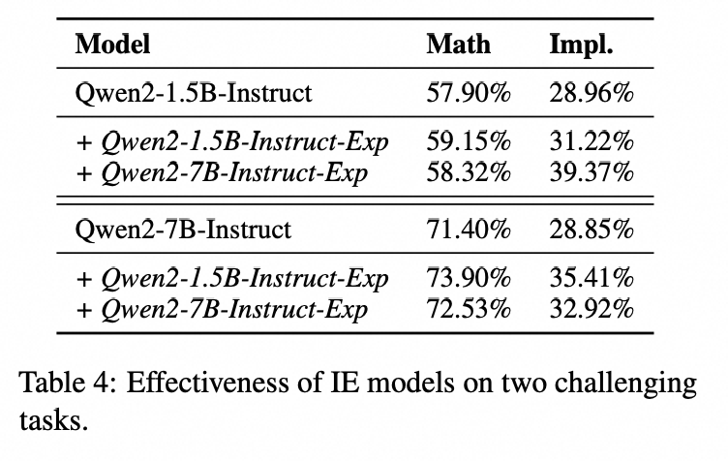
Experiments
Notes:
For prompt refinement evaluation, we take single-turn instructions from MT-Bench as input to Qwen2-1.5B-Instruct and Qwen2-7B-Instruct to generate responses. Two IR models are further leveraged to refine these instructions, before response generation. After that, we employ GPT4-turbo to evaluate the levels of details and truthfulness of the responses, compared with the vanilla outcomes.
We evaluate our instruction expansion models on two tasks from the BIG-Bench benchmark. We choose tasks spanning logical reasoning and commonsense. We split a subset of 100 data instances as seed dataset for the Implicature dataset and 1000 data points for the Elementary Math dataset. We employ our instruction expansion models to expand the seed data to six times its original size., and use Qwen-max to annotate the newly generated data. From Table , our data augmentation technique can still consistently improve the model’s performance by an additional 1-2 percentage points.

Slide 7
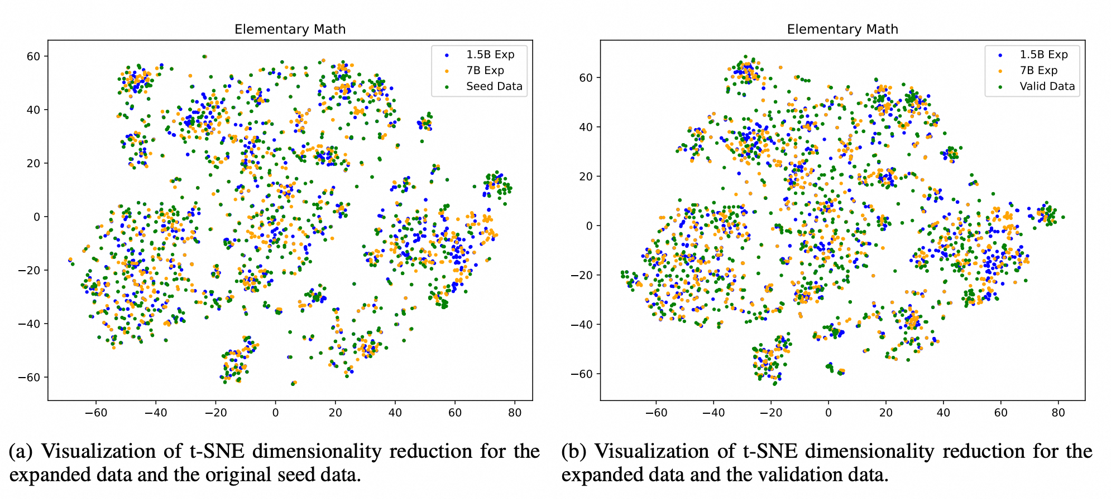
Experiments
Notes:
Figure 5: Distribution of the model expansion and human-written dataset in the embedding space on the Elementary Math dataset. Datasets augmented by our models exhibit substantial regional overlap with the seed dataset, consequently leading to significant overlap with most regions of the validation set. The data generated by the Qwen2- 7B-Instruct-Exp is slightly smoother and more uniform compared to that produced by the Qwen2-1.5B-Instruct-Exp.

Slide 8
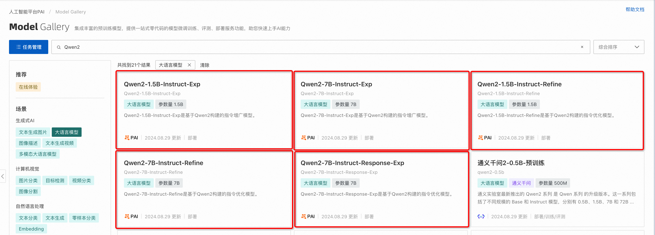
Deploy to cloud services
We have deployed the models on the Alibaba Cloud Platform.
Users can start servers to perform model inference with just one click.

Slide 9
Try our models on HuggingFace
Limitations:
The improvements of our model's prompt re-writing are quite marginal on super powerful LLMs, such as GPT-4.
Our models are not good at irregular prompts, such as extremely long prompts.
Models are publicly available on Huggingface!
- https://huggingface.co/alibaba-pai/Qwen2-7B-Instruct-Refine
- https://huggingface.co/alibaba-pai/Qwen2-7B-Instruct-Exp
Notes:
welcome to try our models.

Slide 10
Thanks!
Yuanhao Yue
School of Computer Science, Fudan University

